Slide 1
Engineering Law-Governed Approaches
Maintainability Concerns - Interaction Laws
Gustavo Carvalho, Carlos Lucena
{guga,lucena}@inf.puc-rio.br
Seminar
Dependability in Open MAS

Slide 2
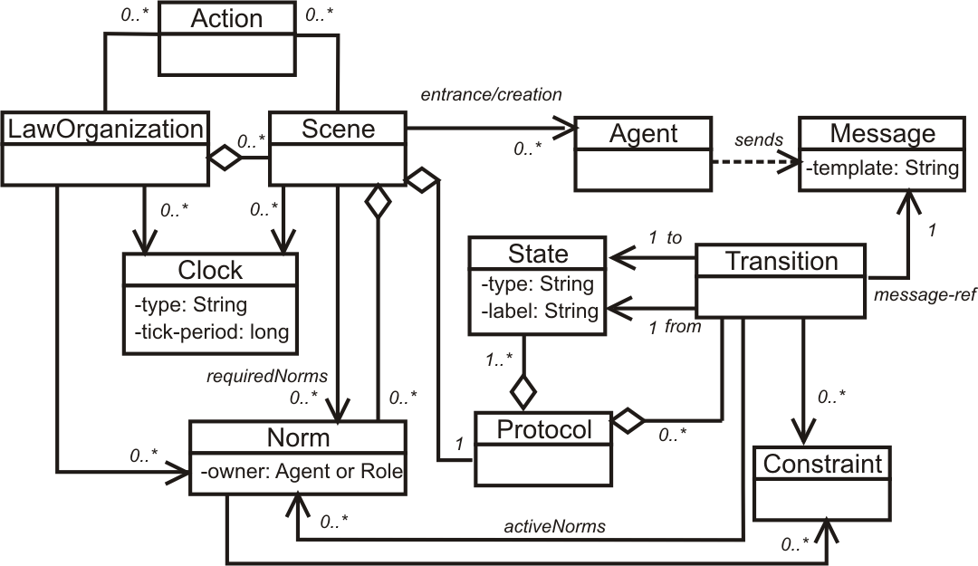
Monitoring laws on interactions
<Laws>
<LawOrganization id="…" name="…">
<Scene id="…" time-to-live="…">
<Creators>…</Creators>
<Entrance>
<Participant role="…" limit="…"/>
</Entrance>
<Messages>…</Messages>
<Protocol>
<States> … </States>
<Transitions>…</Transitions>
</Protocol>
<Norms>... </Norms>
<Clocks>...</Clocks>
<Actions>...</Actions>
</Scene>
</LawOrganization>
</Laws>
Agent A
Agent B
Law Governance
Mechanism

Slide 3
Governance dynamics - General pattern
Wait for messages
Query Context
Apply Laws
Update Context
[not conform]
[ok]
Action
Action
[chain of actions]

Slide 4
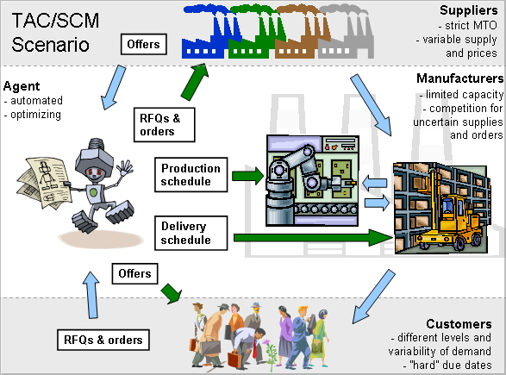
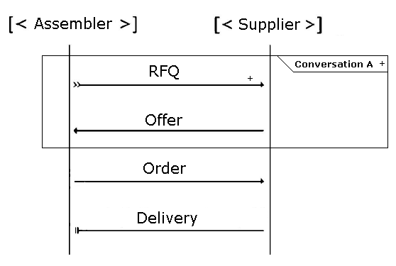
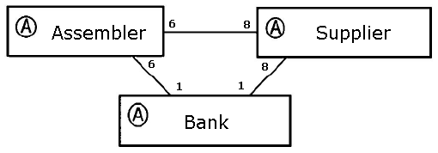
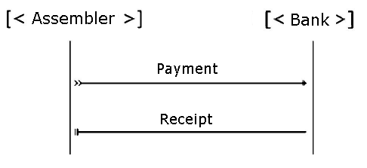
TAC SCM Example

Slide 5
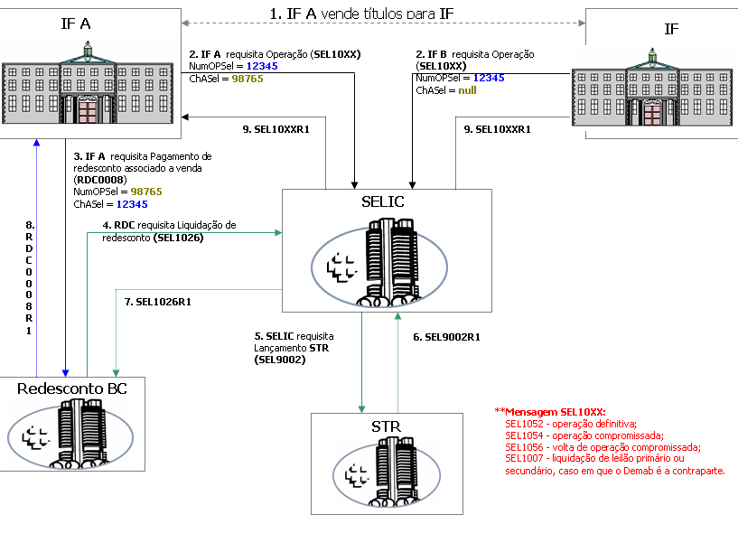
SELIC Example

Slide 6
How to improve the maintainability of interaction laws?
Requirements
  Requirement documentation
Analysis, Design and Implementation
  Design of Open MAS focusing on reuse
  XMLaw Code (with some maintainability support)
Runtime
  Dynamic Law Evolution
  Tests
Formal Analysis
Requirement
Design
Implementation
Runtime
Formal Analysis

Slide 7
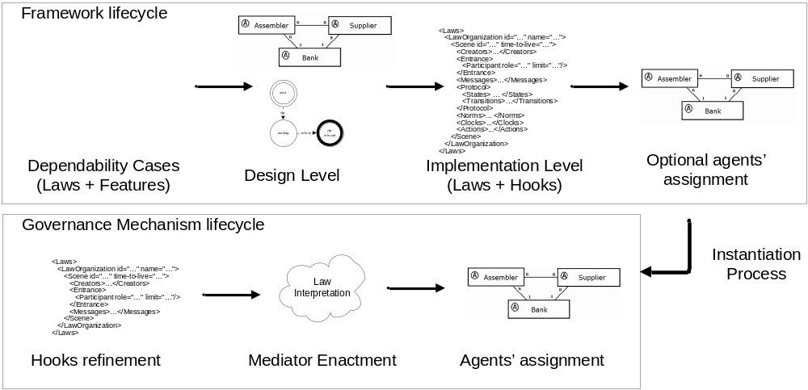
Method Overview

Slide 8
Requirement Analysis
Seminar
Dependability in Open MAS

Slide 9
The Problem
How laws could be structurally mapped from the requirements to interaction laws?
Law Cases
Requirements
Law Requirements

Slide 10
The Solution
Law Cases
  Provide a reusable way of organizing, analyzing, and specifying dependability requirements that will demand law elements
  A law case is
    a documented body of evidence that provides a convincing and valid argument showing that a (software-based) system
    exhibits all desired dependability attributes for a given application in a given environment
    through the rationale of derivation of law elements

Slide 11
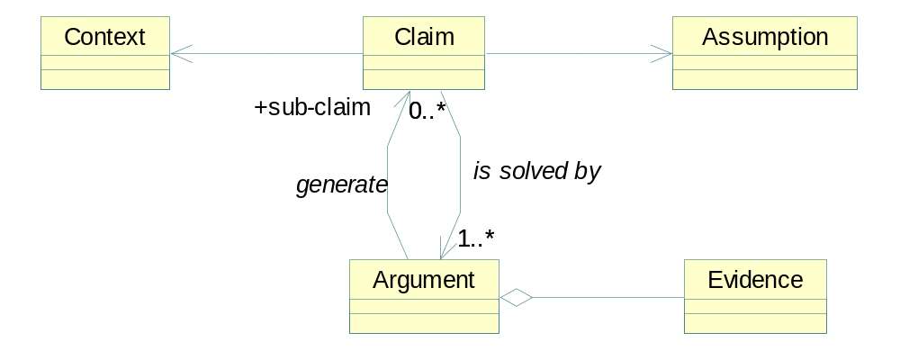
The Solution: The Conceptual Model
Contexto: O comprador aceitou a proposta
Hipótese: O agente comprador não pode falhar.
Suposição: O agente sofreu um ataque e falhou.
Argumento: O módulo de monitoramento da criticalidade de agentes irá detectar a ativação da norma e vai aumentar a criticalidade do agente comprador. O que irá recalcular o número de réplicas.
Evidência: Uma réplica do agente comprador substituiu o agente e ele não falhou.

Slide 12
SELIC Requirement Analysis
Caso de Leis Garantir a Negociação
Caso de Uso: Negociar Título
Risco: SELIC estar sobrecarregado com volume de mensagens
Probabilidade: 60% | Impacto: 0,75
Pré-condições: Existir interessados na negociação (comprador e vendedor para título).
Pós-condições: A negociação foi efetivada segundo as condições válidas e determinadas pelas IFs
Hipótese: O agente SELIC não pode falhar.
Contexto: Existe Comprador e Vendedor para Título
Suposição: Volume de negociações em paralelo podem crescer exponencialmente.
Argumento:
O módulo de monitoramento da criticalidade do SELIC irá detectar o aumento da importância do agente (quantidade de negociações em paralelo) e vai aumentar a criticalidade do agente comprador. O que irá recalcular o número de réplicas.
Evidência: Uma réplica do agente SELIC substituiu o agente e ele não falhou.

Slide 13
Case Study - SELIC
Hugh amount of information regarding the interactions among SELIC and the financial institutions
  400 pages => 59 sections
  How close the interactions are to propose the reuse of specifications?
Filtering
  Approach called bag-of-words
  stop list
  stemmização ( identificação de radicais de palavras )
  Similarity identification
  Comparison among two documents
    Dice, Jaccard and coseno
stop list
stemmer
requirements
Filtering
Vectors
Calculating similarities
Candidates to reuse
 | req1 | req2 | req3 | req4
req1 | 100% | 93% | 25% | 30%
req2 |  | 100% | 30% | 32%
req3 |  |  | 100% | 88%
req4 |  |  |  | 100%

Slide 14
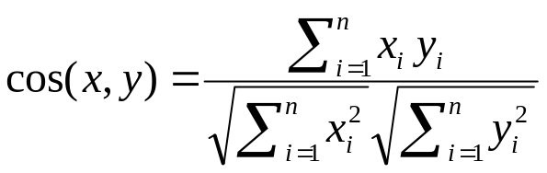
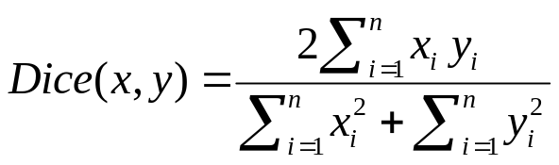
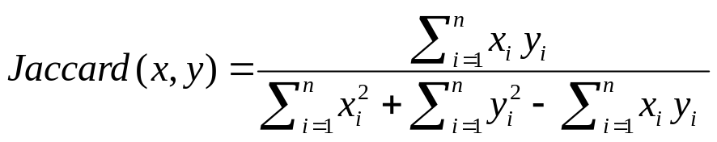
PLN

Slide 15
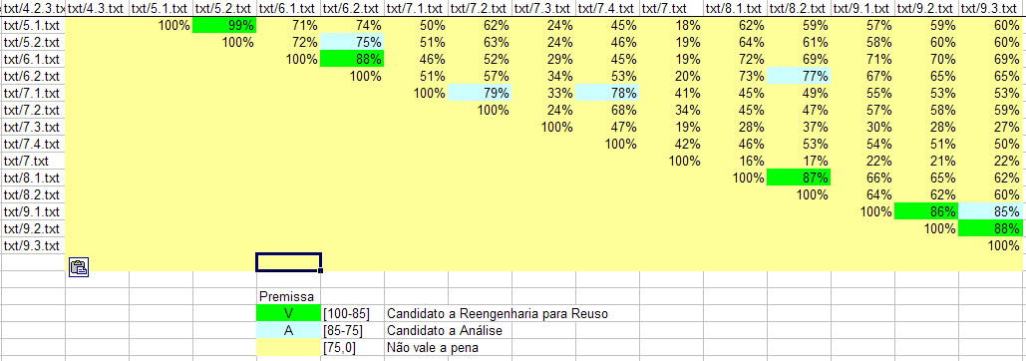
Results
Notes:
Matriz de similaridade
Estrutura utilizada para a comparação de documentos contendo requisitos.
Conceito de janela de análise
Proximidade na descrição dos documentos reflete potenciais candidatos a pontos de extensão.
menor proximidade quanto mais diferentes (menor coincidência de termos) forem os documentos

Slide 16
Analysis, Design and Implementation
Seminar
Dependability in Open MAS

Slide 17
Agenda
Analysis and Design level
  Governance Frameworks
  Extension points
Implementation level
  Extension points
  Refinement operators

Slide 18
Analysis and Design
Governance Frameworks
Seminar
Dependability in Open MAS

Slide 19
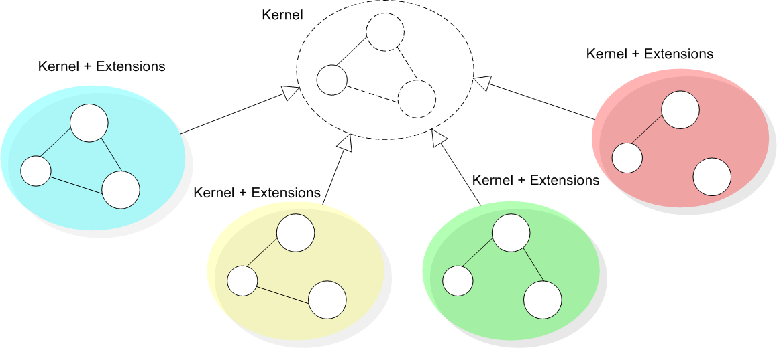
Governance Framework Purpose
We are addressing the problem of constructing a family of governance mechanisms that ensure that agents will conform to a well defined customizable specification.

Slide 20
The research analogy
A framework is a set of abstract and concrete elements that embody a semi-complete solution.
  A framework instance is a set of concrete elements that specializes abstract elements to provide an executable system.
Governance frameworks may demonstrate in practice the ability to gauge enforcement (apply enforcement or, when needed, to relax enforcement) for both complex and changing specifications.
  Besides customizations, the compliance of the system to the specification must continue to be analyzed by a mechanism that governs the laws of interactions in open MAS.

Slide 21
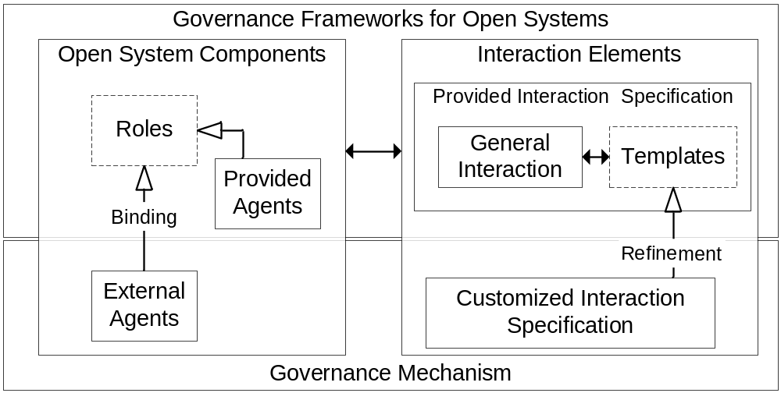
A sketch of the proposed solution

Slide 22
Implementation
Extension points
Seminar
Dependability in Open MAS

Slide 23
Extension points in XMLaw
Law customization is done by a step-wise refinement
  Interaction specification is extensible via law addition, law replacement, or law removal.
How to plug actions and constraints components in the law specification?
  Hooks are a means of representing knowledge about the place in a specification that can be changed by application developers.
  Two phases:
    Other elements definition + specification of hooks
    Hook instantiation → component assignment

Slide 24
Hooks
No class reference
<Actions>
<Action id="anyID">
<Element ref="transition"
event-type="transition_activation"/>
</Action>
</Actions>
<Constraints>
<Constraint id="anyID"/>
</Constraints>
No class reference

Slide 25
Constraint
Constraints are restrictions over norms or transitions and generally specify filters for events, constraining the allowed values for a specific attribute of an event.
  For instance, a constraint can describe what the allowed values for specific attributes are. It can filter the event that is not conform to this rule.
    DueDate < 10/10/2005
    Value > 1000
Constraints are implemented using Java code.
  The class is called when a transition or a norm is supposed to fire, and basically the constraint analyzes if the message values or any other events’ attributes are valid.
    public class CheckValidDay extends AbstractConstraint {
    public boolean constrain(InfoCarrier info) {
    /* manipulate data */
    if ( /*check conditions*/ )
    return true;
    else
    return false;
    }
    }

Slide 26
Constraints in Transitions and Norms
<Transition id=”ab”
from=”a”
to=”b”
message-ref=”m”>
<Constraint id="anId" class="aClass"/>
</Transition>
<Permission id="a-Permission-Id">
<Owner>...</Owner>
<Activations>...</Activations>
<DeActivations>...</DeActivations>
<Constraints>
<Constraint id="anId" class="aClass"/>
</Constraints>
<Actions>...</Actions>
</Permission>
anId = true
a
b
m
anId = false
a
b
m
anId = true
anId = false
Norm
Norm
Activated
Deactivated

Slide 27
Actions
Actions can be used to plug services in an environment.
  For instance, an environment can call a debit service from a bank agent to automatically charge the purchase of a good in a negotiation.
Actions can be activated by any XMLaw event such as transition, norm, and even action activation.
  The class attribute of an Action specifies the java class in charge of the functionality implementation.
<Actions>
<Action id="anActionId“
class="apackage.ActionClass">
<Element ref=“…“ event-type=“.."/>
<Element ref=“…“ event-type=“…"/>
</Action>
</Actions>
public class KeepRFQAction extends ActionExecution {
public void execute(InfoCarrier infoCarrier) throws LawException {
/* action implementation */
}
}

Slide 28
Transition with hook
<Transition id="rfqTransition" from="as1" to="as2“ message-ref="rfq">
<Constraints>
<Constraint id="checkDueDate"/>
</Constraints>
<ActiveNorms>
<Norm ref="AssemblerPermissionRFQ"/>
</ActiveNorms>
</Transition>
<Transition id="rfqTransition" from="as1" to="as2“ message-ref="rfq">
<Constraints>
<Constraint id="checkDueDate“ class="tacscm.constraints.ValiDate2005“ />
</Constraints>
...
</Transition>
No class reference

Slide 29
Permission with hooks
<Permission id="AssemblerPermissionRFQ">
<Owner>Assembler</Owner>
<Activations>
<Element ref="negotiation" event-type="scene_creation"/>
</Activations>
<Deactivations>
<Element ref="orderTransition" event-type="transition_activation"/>
</Deactivations>
<Constraints>
<Constraint id="checkCounter"/>
</Constraints>
<Actions>
<Action id="permissionRenew“ class="tacscm.norm.actions.ZeroCounter">
<Element ref="nextDay" event-type="clock_tick"/>
</Action>
<Action id="orderID">
<Element ref="rfqTransition" event-type="transition_activation"/>
</Action>
</Actions>
</Permission>
<Permission id="AssemblerPermissionRFQ">
…
<Constraints>
<Constraint id="checkCounter“ class="tacscm.norm.constraints.CounterLimit2005"/>
</Constraints>
<Actions>
<Action id="orderID“ class="tacscm.norm.actions.RFQCounter2005">...
</Action>
</Actions>
</Permission>
No class reference
No class reference

Slide 30
Obligation
<Obligation id="ObligationToPay">
<Owner>Assembler</Owner>
<Activations>
<Element ref="orderTransition“
event-type="transition_activation"/>
</Activations>
<Deactivations>
<Element ref="payingTransition“
event-type="transition_activation"/>
</Deactivations>
</Obligation>
<Obligation id="ObligationToPay">
<Owner>Assembler</Owner>
<Activations>
<Element ref="orderTransition“
event-type="transition_activation"/>
</Activations>
<Deactivations>
<Element ref="payingTransition“
event-type="transition_activation"/>
</Deactivations>
<Actions>
<Action id="supplierPayment“
class="tacscm.norm.actions.SupplierPayment">
<Element ref="orderTransition“
event-type="transition_activation"/>
</Action>
</Actions>
</Obligation>
Element inclusion

Slide 31
Implementation
Refinement Operators
Seminar
Dependability in Open MAS

Slide 32
Refinement Operators
abstract=“true” define when a law element is not completely implemented (have hooks) or must be better defined to be used.
completes – fill the “hooks” that were left unspecified
extends – reuses the description of law elements and includes or superposes modifications
<Permission id=“APRFQ2004” completes="AssemblerPermissionRFQ">
<Constraint id="checkCounter"
class="tacscm.norm.constraints.CounterLimit"/>
<Action id="orderID“
class="tacscm.norm.actions.RFQCounter“/>
</Permission>
<Permission id=“APRFQ2004” completes="AssemblerPermissionRFQ">
<Constraint id="checkCounter"
class="tacscm.norm.constraints.CounterLimit2005"/>
<Action id="orderID“
class="tacscm.norm.actions.RFQCounter2005“/>
</Permission>
<Permission id="AssemblerPermissionRFQ“ type=“abstract”>
<Owner>Assembler</Owner>
<Activations>
<Element ref="negotiation"
event-type="scene_creation"/>
</Activations>
<Deactivations>
<Element ref="orderTransition"
event-type="transition_activation"/>
</Deactivations>
<Constraints>
<Constraint id="checkCounter"/>
</Constraints>
<Actions>
<Action id="permissionRenew"
class="tacscm.norm.actions.ZeroCounter">
<Element ref="nextDay" event-type="clock_tick"/>
</Action>
<Action id="orderID">
<Element ref="rfqTransition"
event-type="transition_activation"/>
</Action>
</Actions>
</Permission>

Slide 33
Defining a law element as abstract
Attribute type=“abstract” define when a law element is not completely implemented (have hooks) or must be better defined to be used.
<Permission id=“P“ abstract=“true”>
<Owner>…</Owner>
<Activations> … </Activations>
<Deactivations> … </Deactivations>
<Constraints>
<Constraint id=“constraintA"/>
</Constraints>
<Actions>
<Action id=“…“ class=“…"> … </Action>
<Action id=“actionA">…</Action>
</Actions>
</Permission>
<Permission id=“F“ abstract=“true”>
<Owner>…</Owner>
<Activations> … </Activations>
<Deactivations> … </Deactivations>
<Constraints> … </Constraints>
</Permission>

Slide 34
Refinement Operator Example
Constraint over rfqTransition
completes – fill the “hooks” that were left unspecified
<Transition id="rfqTransition" from="as1" to="as2"
message-ref="rfq“ abstract=“true”>
<Constraints>
<Constraint id="checkDueDate"/>
</Constraints>
<ActiveNorms>
<Norm ref="AssemblerPermissionRFQ"/>
</ActiveNorms>
</Transition>
<Transition id=“rfq2004” completes="rfqTransition">
<Constraint id="checkDueDate"
class="tacscm.constraints.ValiDate"/>
</Transition>
<Transition id=“rfq2005” completes="rfqTransition">
<Constraint id="checkDueDate"
class="tacscm.constraints.ValiDate2005"/>
</Transition>

Slide 35
Refinement Operator Example - Payment process
extends – reuses the description of law elements and includes or superposes modifications
<Obligation id="ObligationToPay“ abstract=“true”>
<Owner>Assembler</Owner>
<Activations>
<Element ref="orderTransition"
event-type="transition_activation"/>
</Activations>
<Deactivations>
<Element ref="payingTransition"
event-type="transition_activation"/>
</Deactivations>
</Obligation>
<Obligation id="ObligationToPay2004“ extends="ObligationToPay">
<Actions>
<Action id="supplierPayment“
class="tacscm.norm.actions.SupplierPayment100">
<Element ref="deliveryTransition"
event-type="transition_activation"/>
</Action>
</Actions>
</Obligation>
<Obligation id="ObligationToPay2005“ extends="ObligationToPay">
<Actions>
<Action id="supplierDownPayment“
class="law.tacscm.norm.actions.SupplierPayment10">
<Element ref="orderTransition"
event-type="transition_activation"/>
</Action>
<Action id="supplierPayment"
class="law.tacscm.norm.actions.SupplierPayment90">
<Element ref="deliveryTransition"
event-type="transition_activation"/>
</Action>
</Actions>
</Obligation>

Slide 36
Implementation Details
Seminar
Dependability in Open MAS

Slide 37
Evolution in Design Time
Base XMLaw
Extended XMLaw
2 steps interpretation
Element Descriptors
Execution Environment

Slide 38
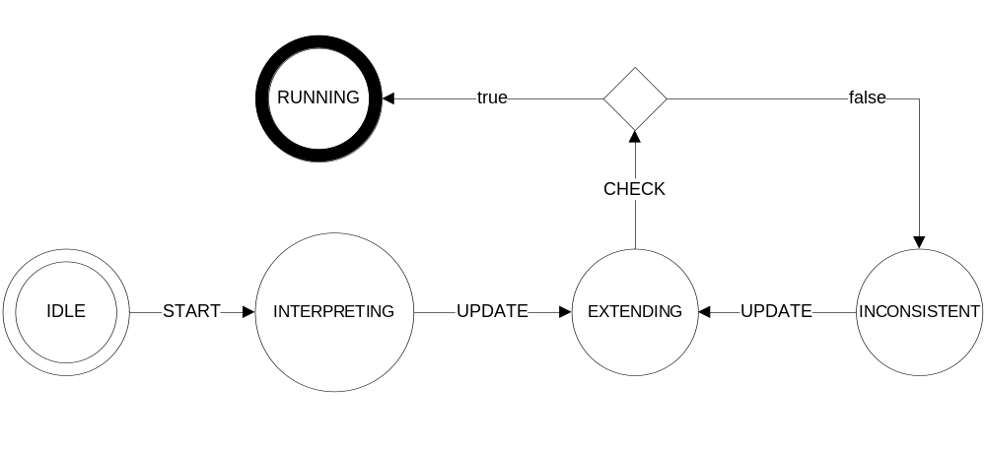
Evolution in Design Time

Slide 39
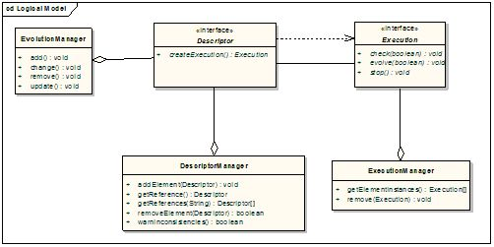
Evolution in Design Time

Slide 40
Related Work
Seminar
Dependability in Open MAS

Slide 41
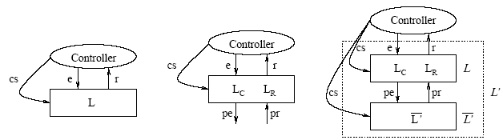
Related Work
Ao and Minsky [2] propose an approach that enhances LGI with the concept of policy-hierarchy to support that different internal policies are formulated independently of each other, achieving a flexibility support by this means.
  Different from our approach, Ao and Minsky consider confidentiality as a requirement for their solution.
  The goal of the extensions that we have presented until now is to support open system law maintenance, rather than flexibility for the purpose of confidentiality.

Slide 42
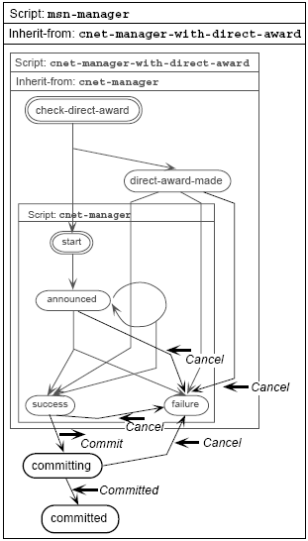
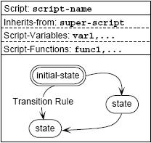
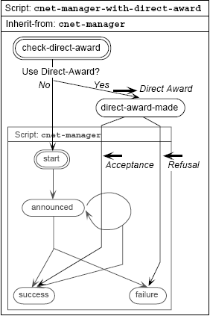
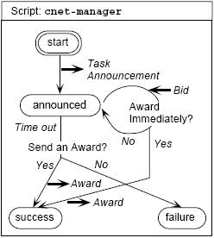
Inheritance - Extension Mechanism
Kuwabara, K., Ishida, T., and Osato, N.: "AgenTalk: Describing Multiagent Coordination Protocols with Inheritance", Proc. 7th IEEE International Conference on Tools with Artificial Intelligence (ICTAI '95) p.460-p.465 (1995)

Slide 43
Related Work
All of these approaches are useful instruments to promote reuse, they can be seen as instruments for specifying extendable laws in governance frameworks.
  COSY [13] views a protocol as an aggregation of primitive protocols.
    Each primitive protocol can be represented by a tree where each node corresponds to a particular situation and transitions correspond to possible messages an agent can either receive or send, i.e., the various interaction alternatives.
  In AgenTalk [17], protocols inherit from one another.
    They are described as scripts containing the various steps of a possible sequence of interactions. Beliefs also are embedded into scripts.
  Koning and Huget [15] deal with the modeling of interaction protocols for multi-agent systems, outlining a component-based approach that improves flexibility, abstraction and protocol reuse.

Slide 44
Related Work
Singh [18] proposes a customizable governance service, based on skeletons.
  His approach formally introduces traditional scheduling ideas into an environment of autonomous agents without requiring unnecessary control over their actions, or detailed knowledge of their designs.
  Skeletons are equivalent to state based machines and we could try to reuse their formal model focusing on the implementation of a family of applications.
  But [18] has few implementation details and examples which could allow us to understand how his proposal was implemented.

Slide 45
Formal Analysis

Slide 46
Overview
We have applied a knowledge-based approach to verify design consistency of interaction laws in XMLaw.
  We provide a formal description of the XMLaw conceptual model, as well as a reasoning engine that are used together to detect structural inconsistencies in XMLaw specification.

Slide 47
Problem Statement
The establishment of the well-formedness of a set of law elements used to design a particular open MAS can be a difficult problem.
The elements specified by using XMLaw can present structural inconsistencies.
  Those inconsistencies result from the interdependencies between law elements.
A conceptual model for XMLaw was defined, but we need to provide some support on the description of a well-formed specification and either to detect and identify if inconsistencies exist.
We need additional support to identify other errors like references to non existent elements, references to elements that are defined in non-visible contexts, and so on.

Slide 48
Proposal
We proposed the use of DL (description logics) and an associated knowledge-based reasoner to verify the consistency of XMLaw specifications.
law
XMLaw
Interpreter
XMLaw
Execution Model
law
Consistency Rules
Reasoner
XMLaw
Interpreter
XMLaw
Execution Model

Slide 49
XMLaw Conceptual Model
An ontology based on the XMLaw conceptual model was developed.
  The purpose of this ontology is to describe formally the XMLaw elements and the relationships among them.
The structural consistency of such laws are verified based on the ontology concepts, properties and axioms.
  We are using the DL implemented by the RACER system to describe our ontology, to check its consistency and to reason about its instances.

Slide 50
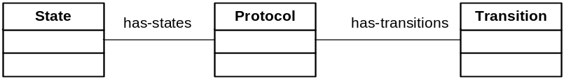

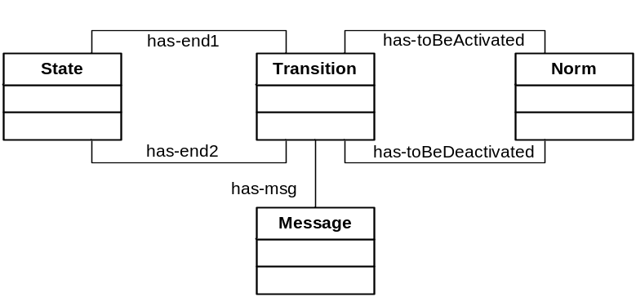
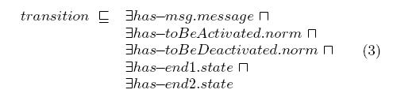
Formalizing – Conceptual Model

Slide 51
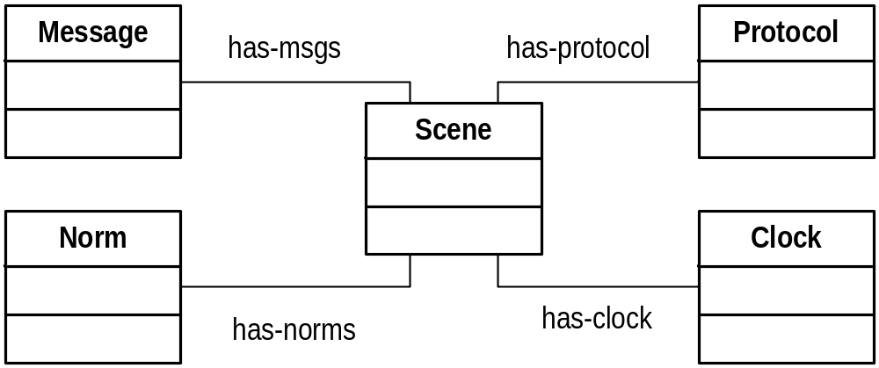
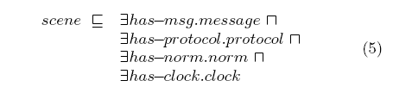
Formalizing – Conceptual Model

Slide 52
Ontology - Instance Example
(instance contractNetOrg organization)
(instance contractNet scene)
(instance contractNetPrtcl protocol)
(instance cfp message)
(instance cfpTransition transition)
(instance start state)
(instance waiting state)
(related contractNet contractNetPrtcl has-protocol)
(related contractNet cfp has-msg)
(related cfpTransition cfp has-msg)
(related cfpTransition start has-end1)
(related cfpTransition waiting has-end2)
(related ContractNetPrtcl cfpTransition has-transition)
(related ContractNetPrtcl start has-state)
(related ContractNetPrtcl waiting has-state)
(instance propose message)
(instance proposeTransition transition)
(instance proposed state)
(related proposeTransition propose has-msg)
(related proposeTransition waiting has-end1)
(related proposeTransition proposed has-end2)
...

Slide 53
Structural Verification
...
(instance waiting state)
(instance proposeTransition transition)
(instance proposed state)
...
(related proposeTransition waiting has-end1)
(related proposeTransition proposed has-end2)
waiting
has-end1
has-end2
proposed
proposeTransition

Slide 54
Structural Verification
(retrieve (?trans-no-s1)
(and (?trans-no-s1 transition)
(?s2 state)
(?trans-no-s1 ?s2 has-end2)
(?trans-no-s1 nil has-end1)))
waiting
has-end1
proposeTransition
has-end2
proposed
(retrieve (?trans-no-s2)
(and (?trans-no-s2 transition)
(?s1 state)
(?trans-no-s2 nil has-end2)
(?trans-no-s2 ?s1 has-end1)))
waiting
has-end1
proposeTransition
has-end2
proposed

Slide 55
Conclusion
We have a very basic description of XMLaw elements and a very basic DL knowledge base.
  Those DL specifications could be enriched with more information.
  This would also allow the reasoner to make more precise inferences.

Slide 56
Conclusion

Slide 57
Conclusions
We are addressing the problem of constructing governance mechanisms that ensure that agents will conform to a well defined customizable specification.
  Our main goal is to contribute on the engineering on how we can productively define and reuse laws.
We are contributing with the study on how to engineer governance mechanisms development.

Slide 58
Future Work
Extension points documentation
Law awareness agents
Make more experiments
Formal analysis must be improved
  Maintainability - Consistency checks

Slide 59
Papers

Slide 60
Papers
G. Carvalho, C. Lucena, R. Paes, J.P. Briot. Refinement Operators to Facilitate the Reuse of Interaction Laws in Open Multi-Agent Systems. 5th International Workshop on Software Engineering for Large-scale Multi-Agent Systems (SELMAS) at ICSE 2006.
G. Carvalho, C. Lucena, R. Paes, J.P. Briot. Refinement Operators to Facilitate the Reuse of Interaction Laws in Open Multi-Agent Systems. 5th International Workshop on Software Engineering for Large-scale Multi-Agent Systems (SELMAS) at ICSE 2006.
G. Carvalho, C. Lucena, R. Paes, J.P. Briot, R. Choren. A Governance Framework Implementation for Supply Chain Management Applications as Open Multi-Agent System. 7th International Workshop on AGENT-ORIENTED SOFTWARE ENGINEERING (AOSE-2006) at AAMAS 2006
G. Carvalho, A. Brandão, R. Paes, C. Lucena. Interaction Laws Verification Using Knowledge-based Reasoning. Workshop on AGENT-ORIENTED INFORMATION SYSTEMS (AOIS-2006) at AAMAS 2006.
CARVALHO, Gustavo; LUCENA, Carlos. A Governance Framework for Open Systems. Doc. Mentoring AAMAS 2006.
CARVALHO, Gustavo; PAES, Rodrigo; LUCENA, Carlos; Extensions on Interaction Laws in Open Multi-Agent Systems. First Workshop on Software Engineering for Agent Oriented Systems, Brazilian Symposium on Software Engineering (SBES2005). Uberlândia, Brazil, Outubro 03, 2005.
RODRIGUES, Luiz Fernando; CARVALHO, Gustavo; PAES, Rodrigo; LUCENA, Carlos; Towards an Integration Test Architecture for Open MAS. First Workshop on Software Engineering for Agent Oriented Systems, Brazilian Symposium on Software Engineering (SBES2005). Uberlândia, Brazil, Outubro 03, 2005.
PAES, Rodrigo de Barros; CARVALHO, Gustavo Robichez de; LUCENA, Carlos José Pereira de; ALENCAR, Paulo S. C.; ALMEIDA, Hyggo Oliveira de; SILVA, Viviane Torres da. Specifying Laws in Open Multi-Agent Systems. In: Agents, Norms and Institutions for Regulated Multiagent Systems (ANIREM), 2005, Utrecht, The Netherlands.
Gustavo Carvalho, Rodrigo Paes, Ricardo Choren, Paulo Alencar e Carlos Lucena. Increasing Software Infrastructure Dependability through a Law Enforcement Approach. 1st International Symposium on Normative Multiagent Systems (NorMAS2005).
PAES, Rodrigo de Barros, CARVALHO, Gustavo Robichez, ALMEIDA, H.O., LUCENA, Carlos José Pereira, ALENCAR, Paulo C.S.; A conceptual architecture for law-governed open multi-agent systems. Anais do Simposio Argentino de Ingeniería de Software (ASSE 2004) - 33 Jornadas Argentinas de Informática e Investigación Operativa (33 JAIIO). Marcelo Campo, Jorge Boria. Sociedad Argentina de Informática e Investigación Operativa, SADIO. Cordoba, Argentina. 20 a 24 de setembro de 2004, Córdoba, Argentina. Proceedings em CD
Gustavo Carvalho, Rodrigo Paes, Ricardo Choren, Carlos Lucena. Towards a Risk Driven Method for Developing Law Enforcement Middleware. Proceedings of the Third International Workshop on Agent-Oriented Methodologies - 19th Annual ACM Conference on Object-Oriented Programming, Systems, Languages, and Applications (OOPSLA 2004). Cesar Gonzalez-Perez, Centre for Object Technology Applications and Research, COTAR, Sydney, Austrália. 24 a 28 de outubro de 2004, Vancouver, Canadá, ISBN: 0-9581915-4-9, páginas: 75-86. Refereed Publications In Conference Proceedings

